Slide 1
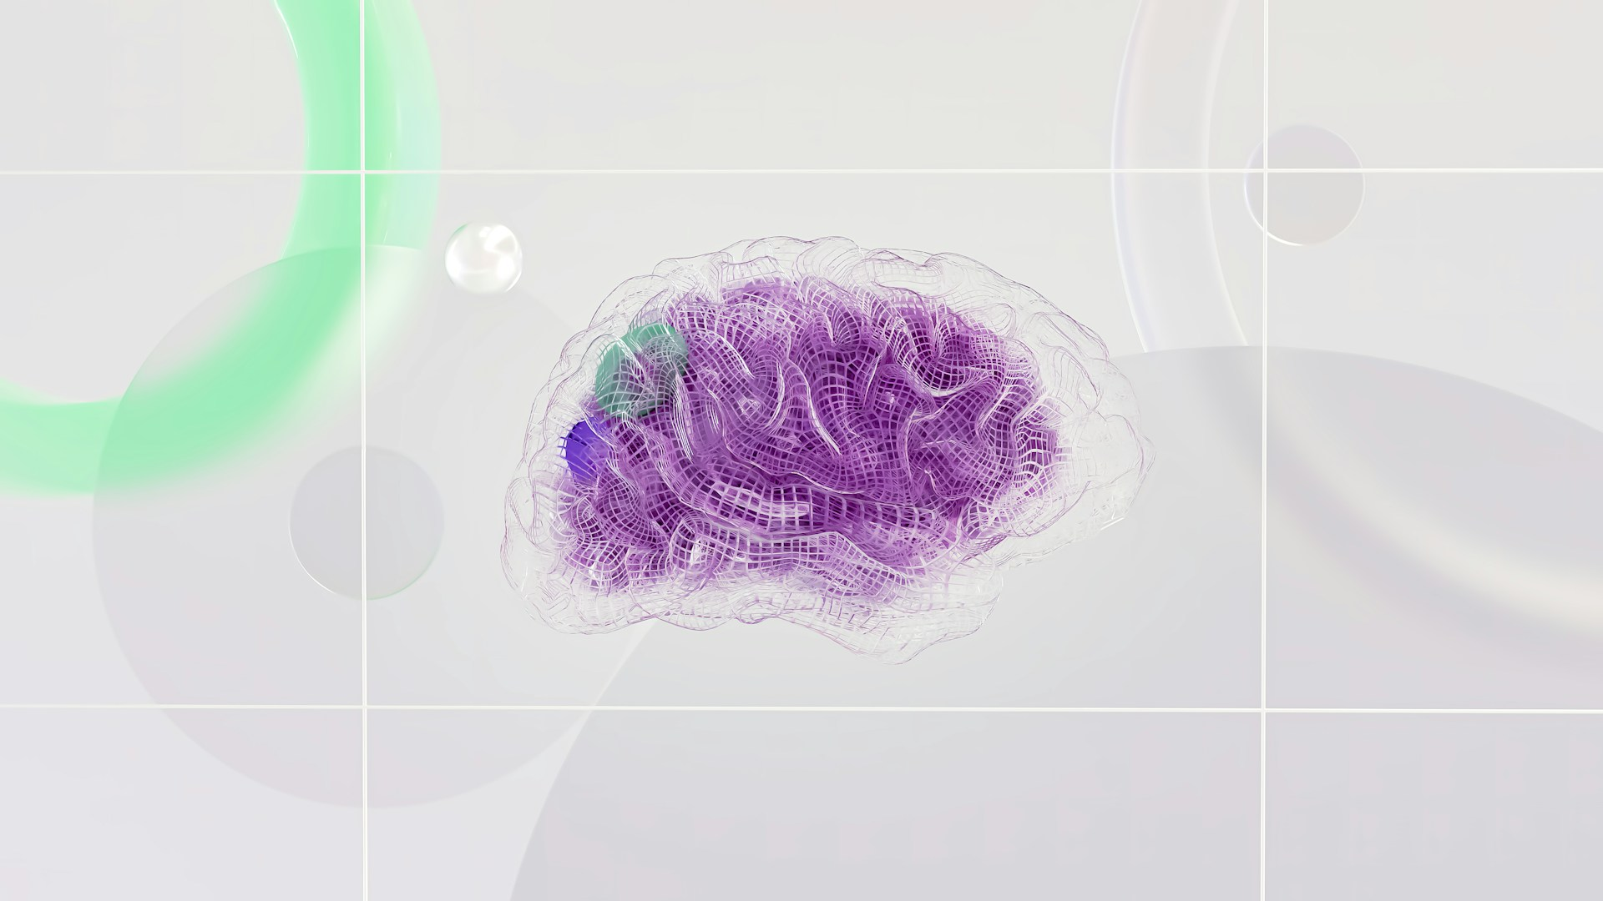
Agentic AI Systems
Amity University Bengaluru
Mayur Madnani

Slide 2
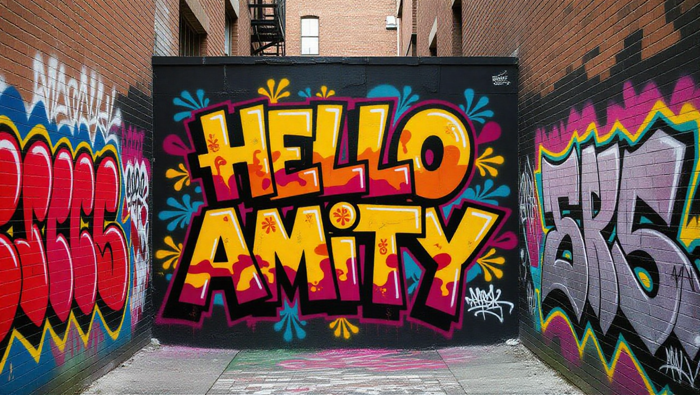

Slide 3
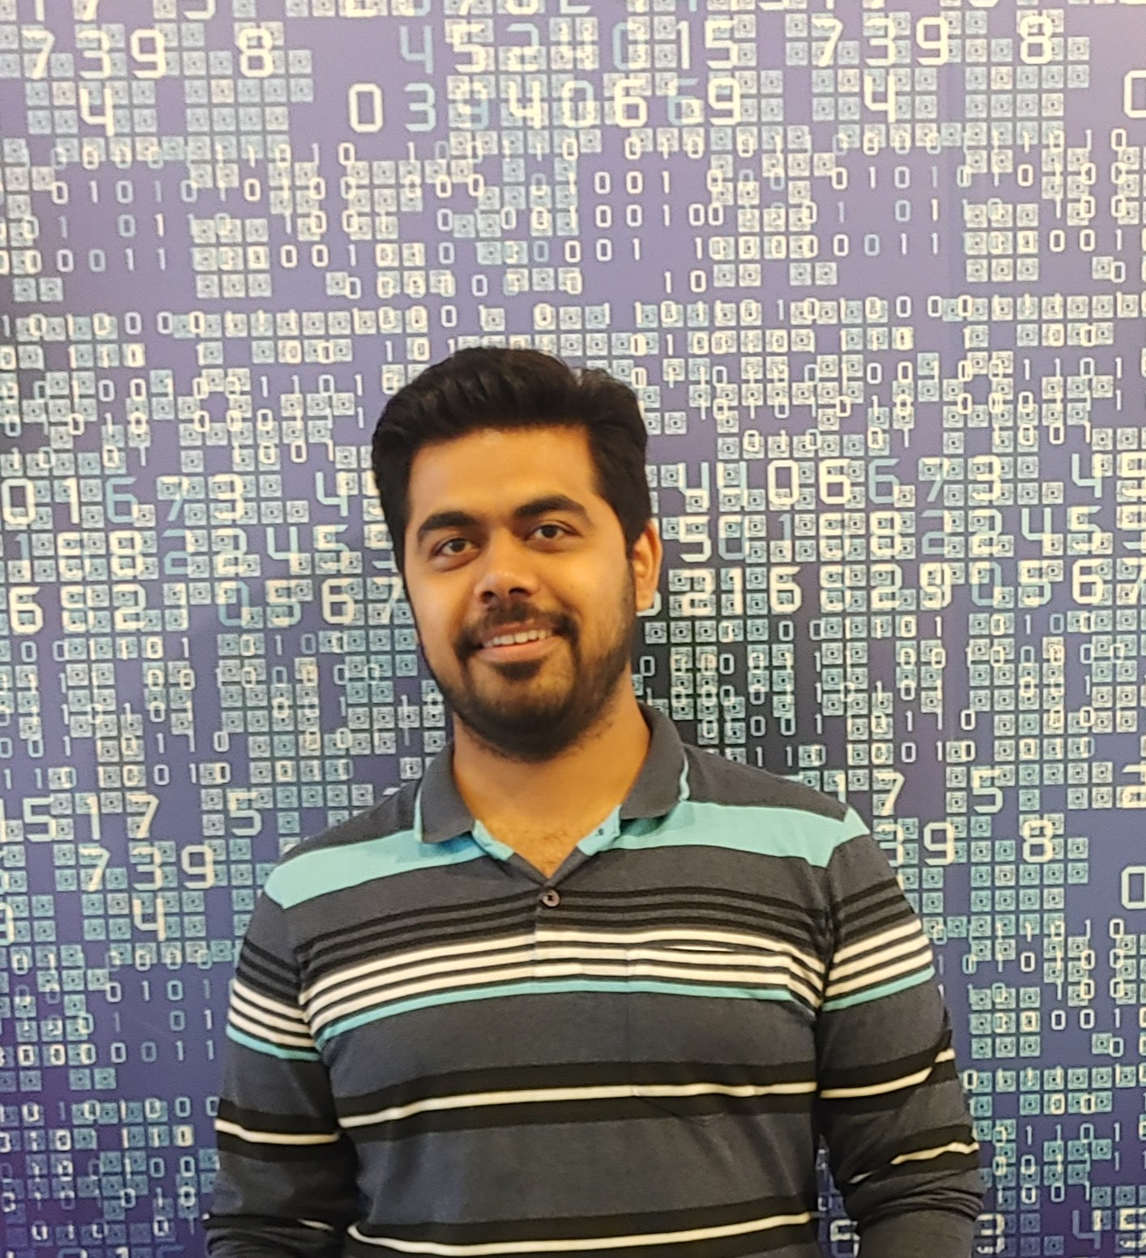
Who Am I?
Staff Engg @ JioHotstar
Previously @ Intuit, Walmart, SAP
Expertise in Data, AI and Backend
~10 years in the Industry
GenAI Course Author
Speaker & Mentor
Mayur Madnani

Slide 4
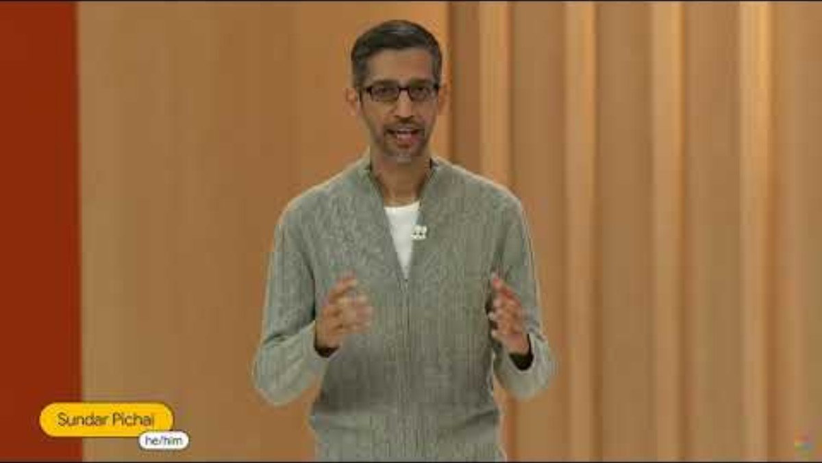

Slide 5
AI Evolution
ERA 1
ERA 2
ERA 3
ERA 4
Rules-Based AI
Deterministic logic
Hand-crafted, predefined rules
Task-specific automation
Minimal adaptability and learning
Machine Learning
Learns patterns from data
Statistical modeling and optimization
Prediction and classification
Improves performance with experience
Generative AI
Creates text, images, code, and media
Trained on large-scale data
Context-aware and conversational
Produces human-like outputs
Agentic AI
Autonomous
Interacts with tools and environments
Continuously learns and adapts
Perceive - Reason - Act - Learn
https://ourworldindata.org/brief-history-of-ai
https://r0bk.github.io/killedbyllm/

Slide 6
AI Agent!
Agent
Reason
Plan
Act
Model
Memory
Tools
AI Agent

Slide 7
Why Multi-Agent?
https://arxiv.org/abs/2506.02153
https://arxiv.org/abs/2511.18258
https://blog.langchain.com/benchmarking-multi-agent-architectures/
https://microsoft.ai/news/the-path-to-medical-superintelligence/

Slide 8
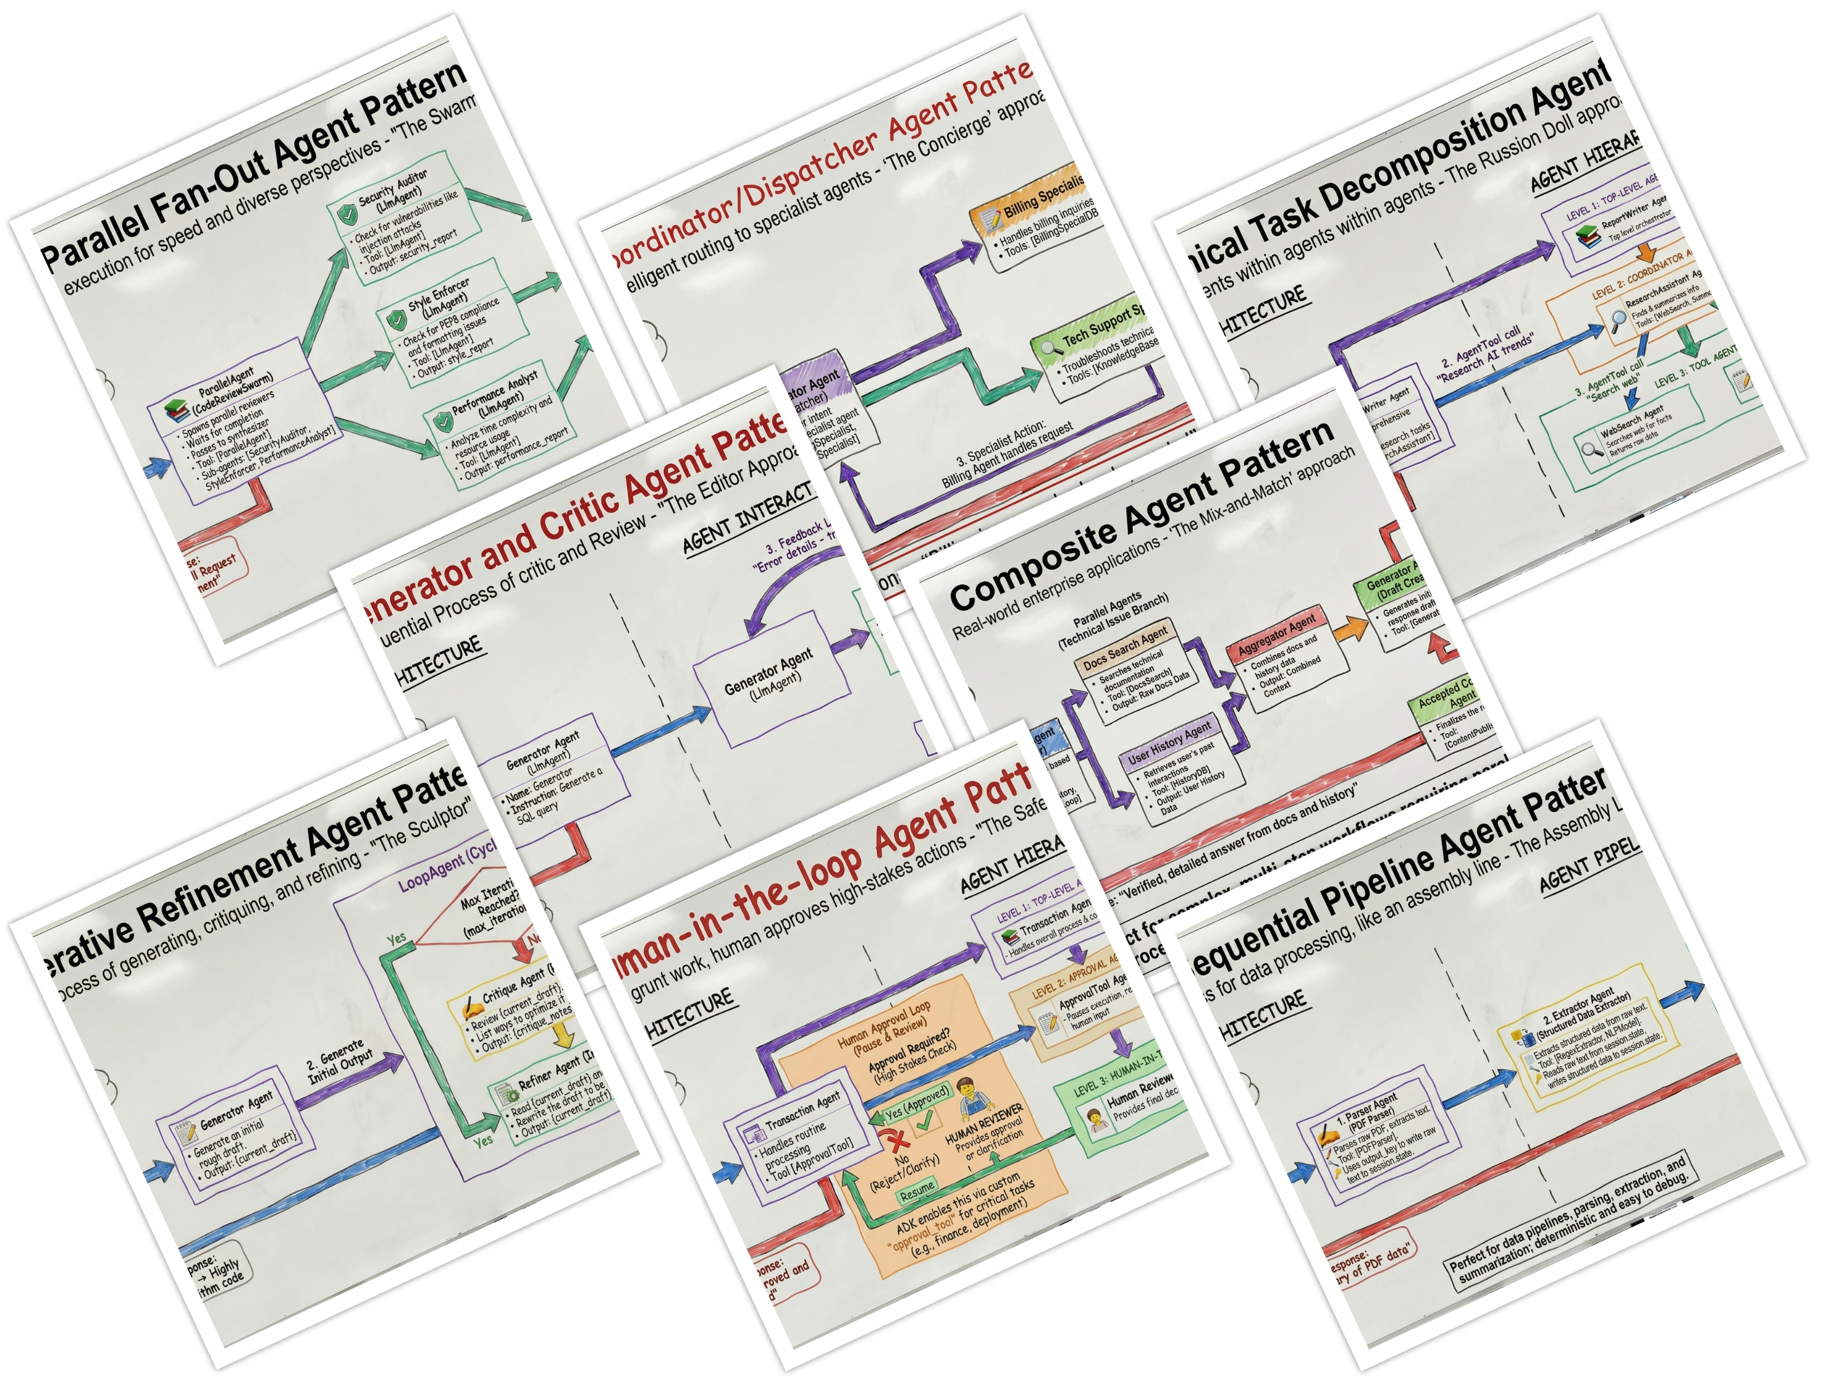
Multi-Agent Design Patterns
https://developers.googleblog.com/developers-guide-to-multi-agent-patterns-in-adk/

Slide 9
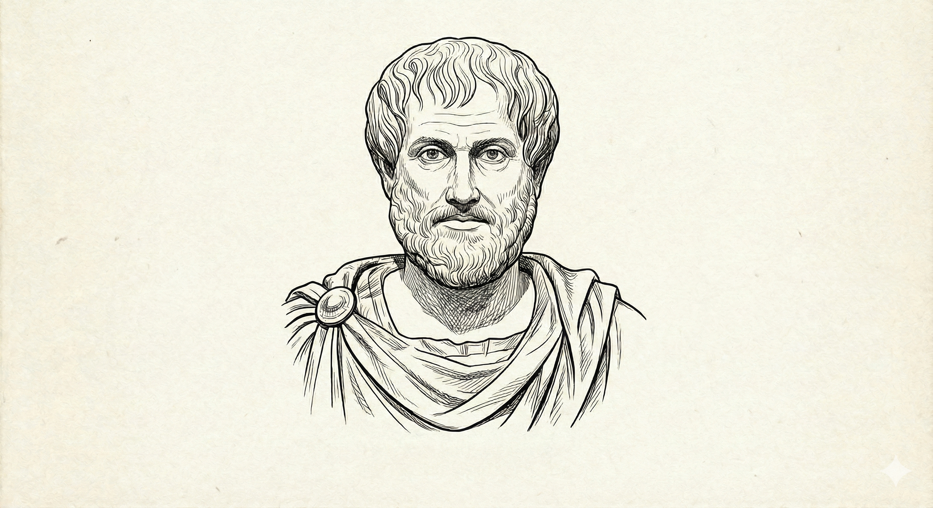
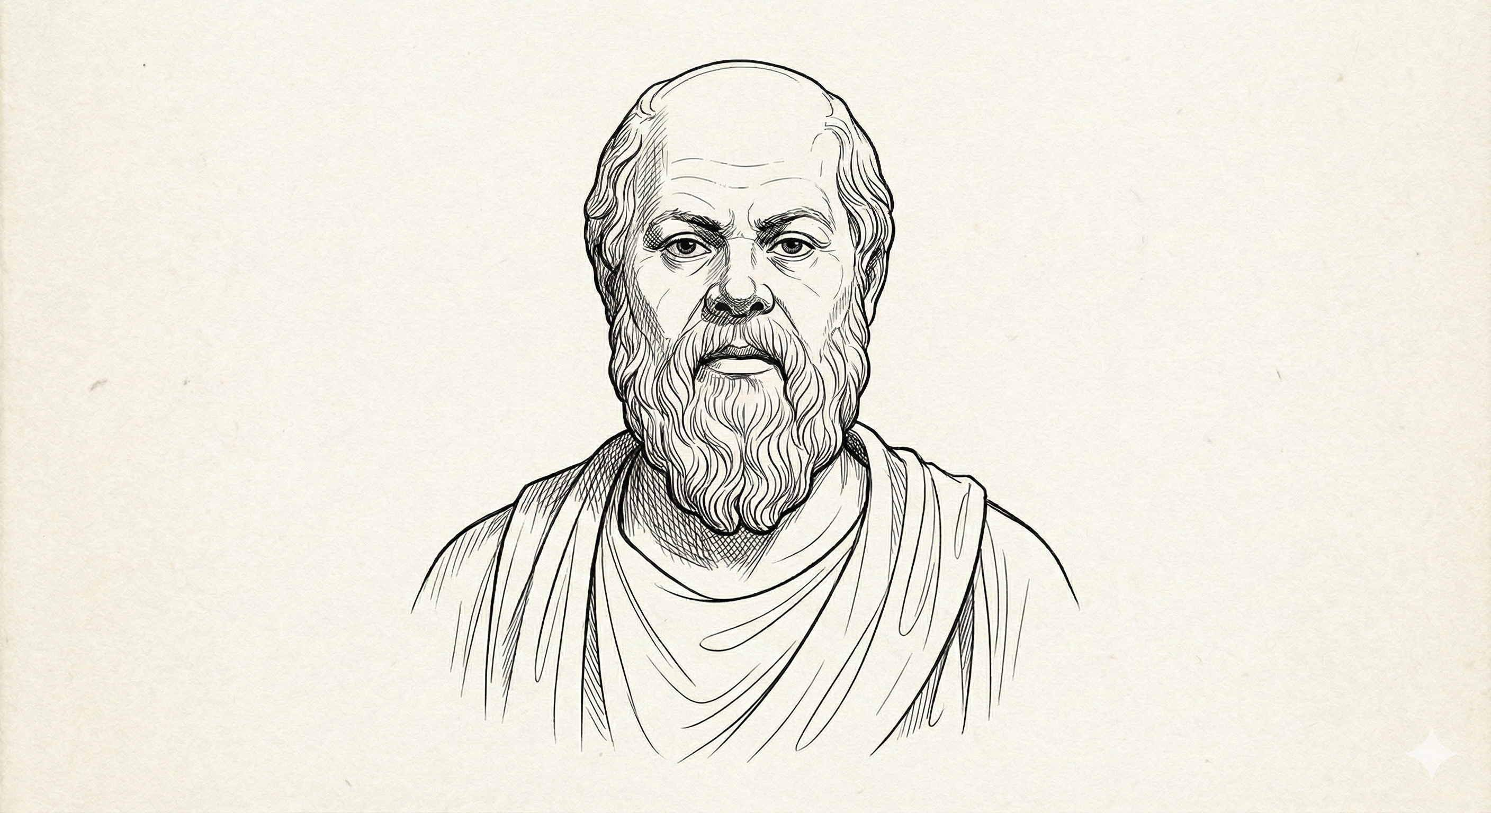
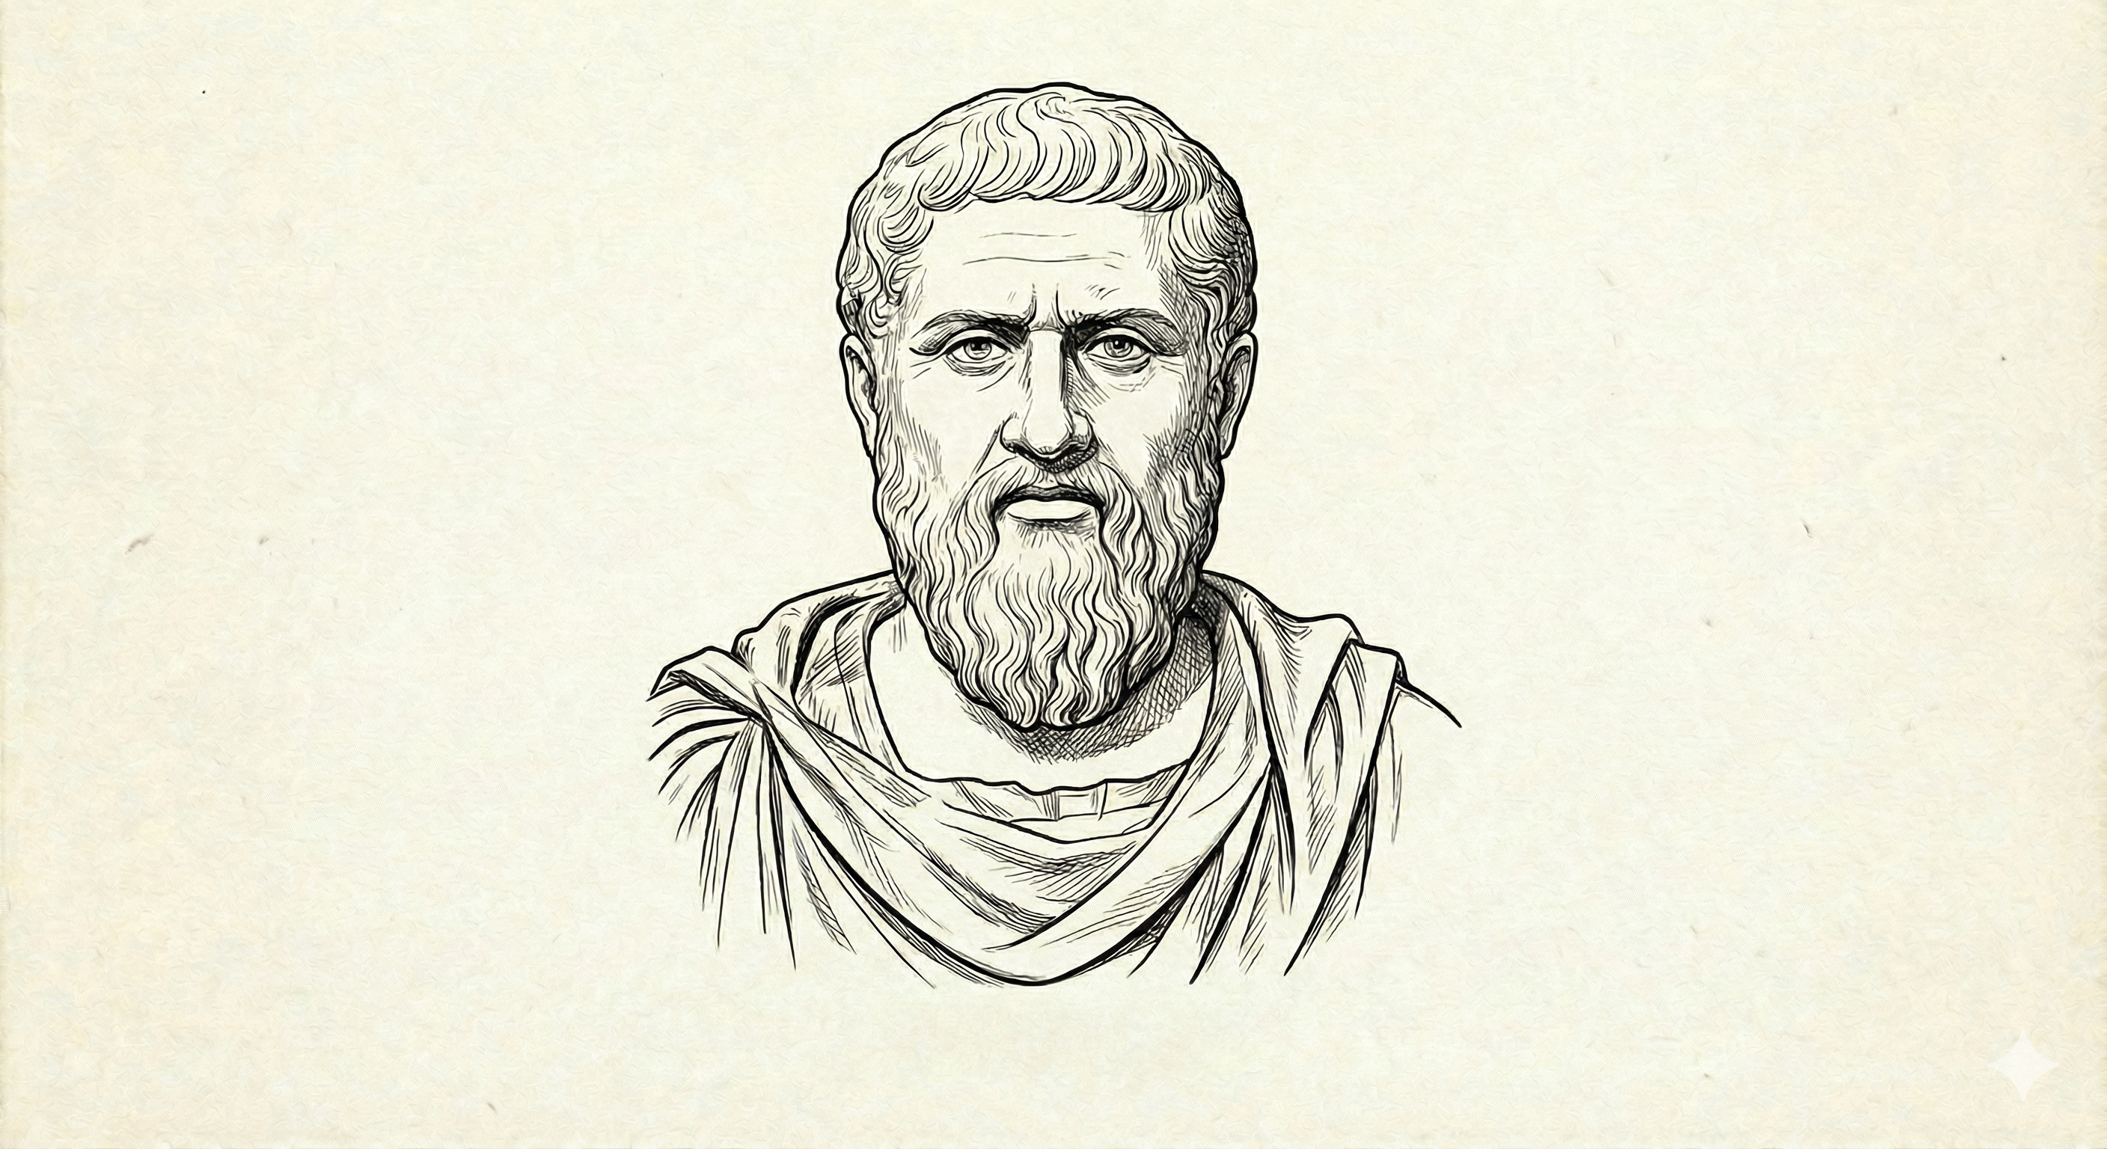
DEMO TIME
Aristotle
The Empiricist
Analyzes systematically, focuses on logic, evidence, and categorization.
Socrates
The Questioner
Challenges assumptions, asks probing questions, promotes critical thought.
Plato
The Idealist
Seeks ideal forms, metaphysical truths, and moral dimensions.
https://github.com/mayurmadnani/multi-agent-debate

Slide 10
Reasoning & Debate Demos
Demo | Agents | Goal
The Great Scientific Debate | Einstein, Newton, Feynman | Discuss or solve a physics or scientific paradox (e.g., “Does time really flow?”)
The Legal Tribunal | Prosecutor, Defense Lawyer, Judge | Evaluate a moral or legal dilemma (e.g., “Is AI-generated art theft?”)
The Policy Roundtable | Economist, Environmentalist, Technologist, Ethicist | Design a balanced policy for a complex issue (AI in healthcare, climate tradeoffs)

Slide 11
Creativity & Co-Creation Demos
Demo | Agents | Goal
The Story Forge | Plot Architect, Character Designer, World Builder, Editor | Collaboratively write a story or screenplay from a user prompt
The Composer’s Circle | Lyricist, Composer, Producer | Co-create a song or jingle with the user
The Ad Campaign Braintrust | Creative Director, Copywriter, Marketing Analyst | Generate and refine an ad campaign concept for a product

Slide 12
Problem-Solving & Planning Demos
Demo | Agents | Goal
The Engineering Design Board | Systems Engineer, Designer, Project Manager | Solve a technical challenge (e.g., “Design a Mars rover communication system”)
The Startup Founders’ Table | CEO, CTO, CFO, Marketing Lead | Launch a hypothetical startup based on a user idea
The Research Lab | Data Scientist, Statistician, Domain Expert | Analyze a dataset or research hypothesis

Slide 13
Humanistic or Reflective Demos
Demo | Agents | Goal
The Council of Wisdom | Socrates, Buddha, Nietzsche, AI Philosopher | Discuss ethics or meaning of life topics from different philosophical lenses
The Time-Travel Symposium | A Roman Senator, A Medieval Monk, A Modern Scientist, A Future AI | Discuss “progress” or “truth” across time
The Therapist Collective | Cognitive-Behavioral Therapist, Existential Therapist, Mindfulness Coach | Give diverse therapeutic takes on a user’s reflective prompt

Slide 14
Meta-AI and Agentic Intelligence Demos
Demo | Agents | Goal
The AI Constitution | Safety Researcher, Philosopher of AI, Engineer, Policy Regulator | Write a short “AI Code of Conduct.”
The AI Debate Club | Optimist AI, Skeptic AI, Moderator | Debate “Will AI surpass human creativity?”
The Swarm Planner | Scout AI, Analyst AI, Planner AI, Coordinator AI | Plan a multi-step mission (e.g., deliver disaster aid using drones)

Slide 15
Educational or Interactive Demos
Demo | Agents | Goal
The Tutor Panel | Math Tutor, History Tutor, Science Tutor, Philosopher Tutor | Co-teach a concept from multiple perspectives
The Debate Classroom | Pro-Argument, Con-Argument, Moderator, Student Summarizer | Teach critical thinking through structured debate
The “AI as Socratic Mentor” | Teacher, Student, Observer | Simulate the Socratic method for teaching logic or ethics

Slide 16
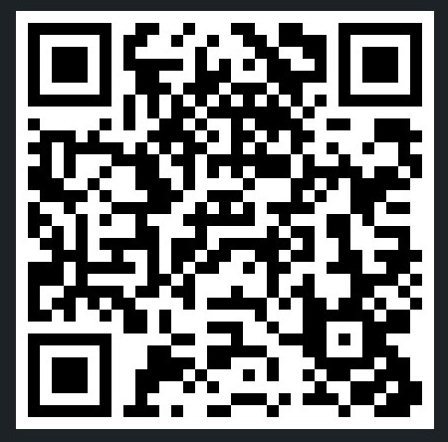
Thank You!!
https://linkedin.com/in/mayurmadnani

